Slide 1
Rent Control
ECON 3320 – Urban Economics
Professor Patrick Button

Slide 2
In this chapter (Ch 7)
In this chapter we will examine a few policies that seek to make housing more affordable and accessible. We will look at:
1) rent control
2) housing subsidies
3) minimum dwelling size

Slide 3
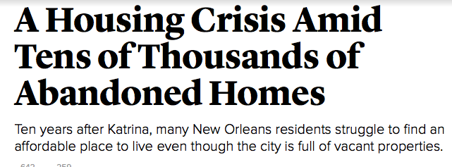
Why Housing Policy?
Having housing is crucial, families without it face significant challenges to health (physical and mental), safety, and employment (to name a few).
Many families face challenges either getting housing at all, or getting adequate housing.

Slide 4
Would Rent Control Help?
Rent control creates legal restrictions to what can be charged in rent.
Rent control creates a price ceiling – price cannot increase above this ceiling.
The goal is to make housing rent cheaper by forcing rents lower.

Slide 5
Types of Rent Control Laws
Rent control laws differ by region but they typically limit the rate of increase of rent for a dwelling during a tenant’s period of residence.
So if you rent a property that has rent control, your landlord can only increase rent up to the maximum percent increase per year.
But if you move out and the landlord rents to someone else, she can then increase the rent before she puts your old dwelling back on the market (called “vacancy decontrol”)
New buildings are often exempted from rent control laws.

Slide 6
Types of Rent Control Laws
While most rent control laws have this feature (“vacancy decontrol”), some don’t.
Laws that do not allow vacancy decontrol (landlords can’t re-adjust rents when tenants leave) are deemed to be strong rent control.
Strong rent control laws: CA (West Hollywood, Santa Monica, Berkeley, East Palo Alto, Cotati)
But these strong rent control laws are unenforceable since 1996 after the Costa-Hawkins Rental Housing Act.
(More on the CA case during a guest lecture by Brian Asquith, PhD Candidate at the University of California, Irvine. Friday Nov. 20th – “Rent Control and Evictions: Evidence from San Francisco”)

Slide 7
What does economics say about Rent Control?
Two types of economics research will help us determine the effects of rent control:
1) Predictions from economic models
2) Empirical evidence (e.g., difference-in-difference statistical studies)
We will look at both sets of evidence, starting with 1)

Slide 8
Predictions from Economic Models
There are different models of the economy that will generate different predictions of the impact of rent control.
Consider two extremes:
1) Percent competition
2) Monopoly
Under perfect competition, rent control will have adverse consequences, making it undesirable.
Under a monopoly, there is a greater likelihood for beneficial outcomes.

Slide 9
Rent Control under Perfect Competition
Under perfect competition, the market is extremely competitive.
No firms have market power.
No consumers have market power.
Market price is determined by supply and demand and is exogenous.

Slide 10
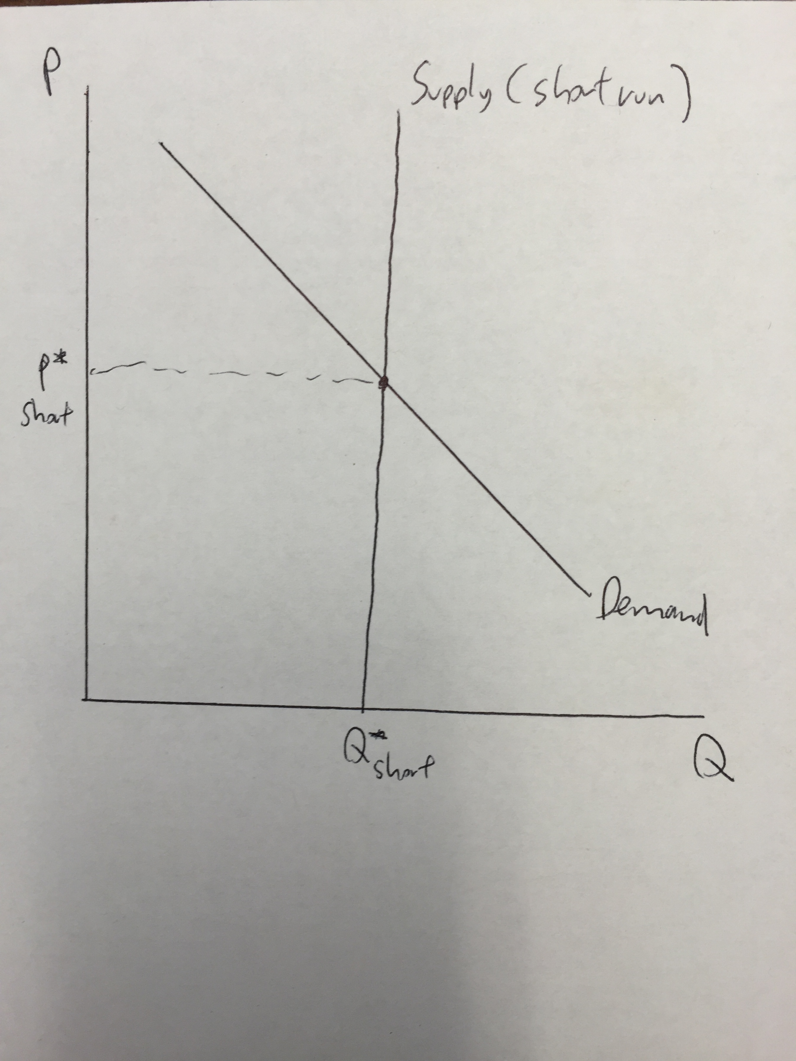
Long Run vs Short Run
Housing developers can’t build new housing immediately, so housing supply in the short run is fixed (vertical line)
Equilibrium occurs where the downward sloping demand curve intersects the short run supply curve.

Slide 11
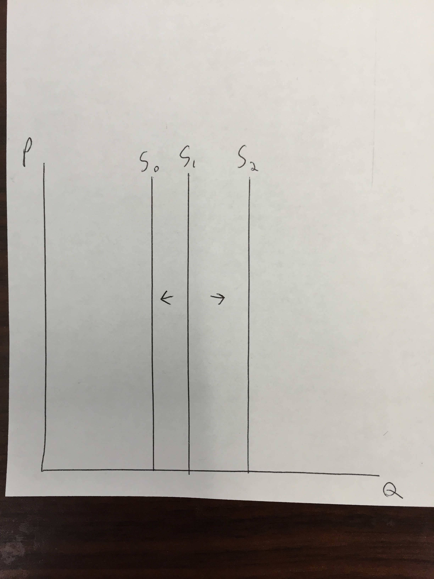
Long Run vs Short Run
In the long run, housing developers can change the housing stock by building more units (S1 to S2) or by letting some units fall into disrepair (S1 to S0).
Since populations are increasing in more cities, it’s usually a matter of how much housing gets built in the long run (a lot vs a little)

Slide 12
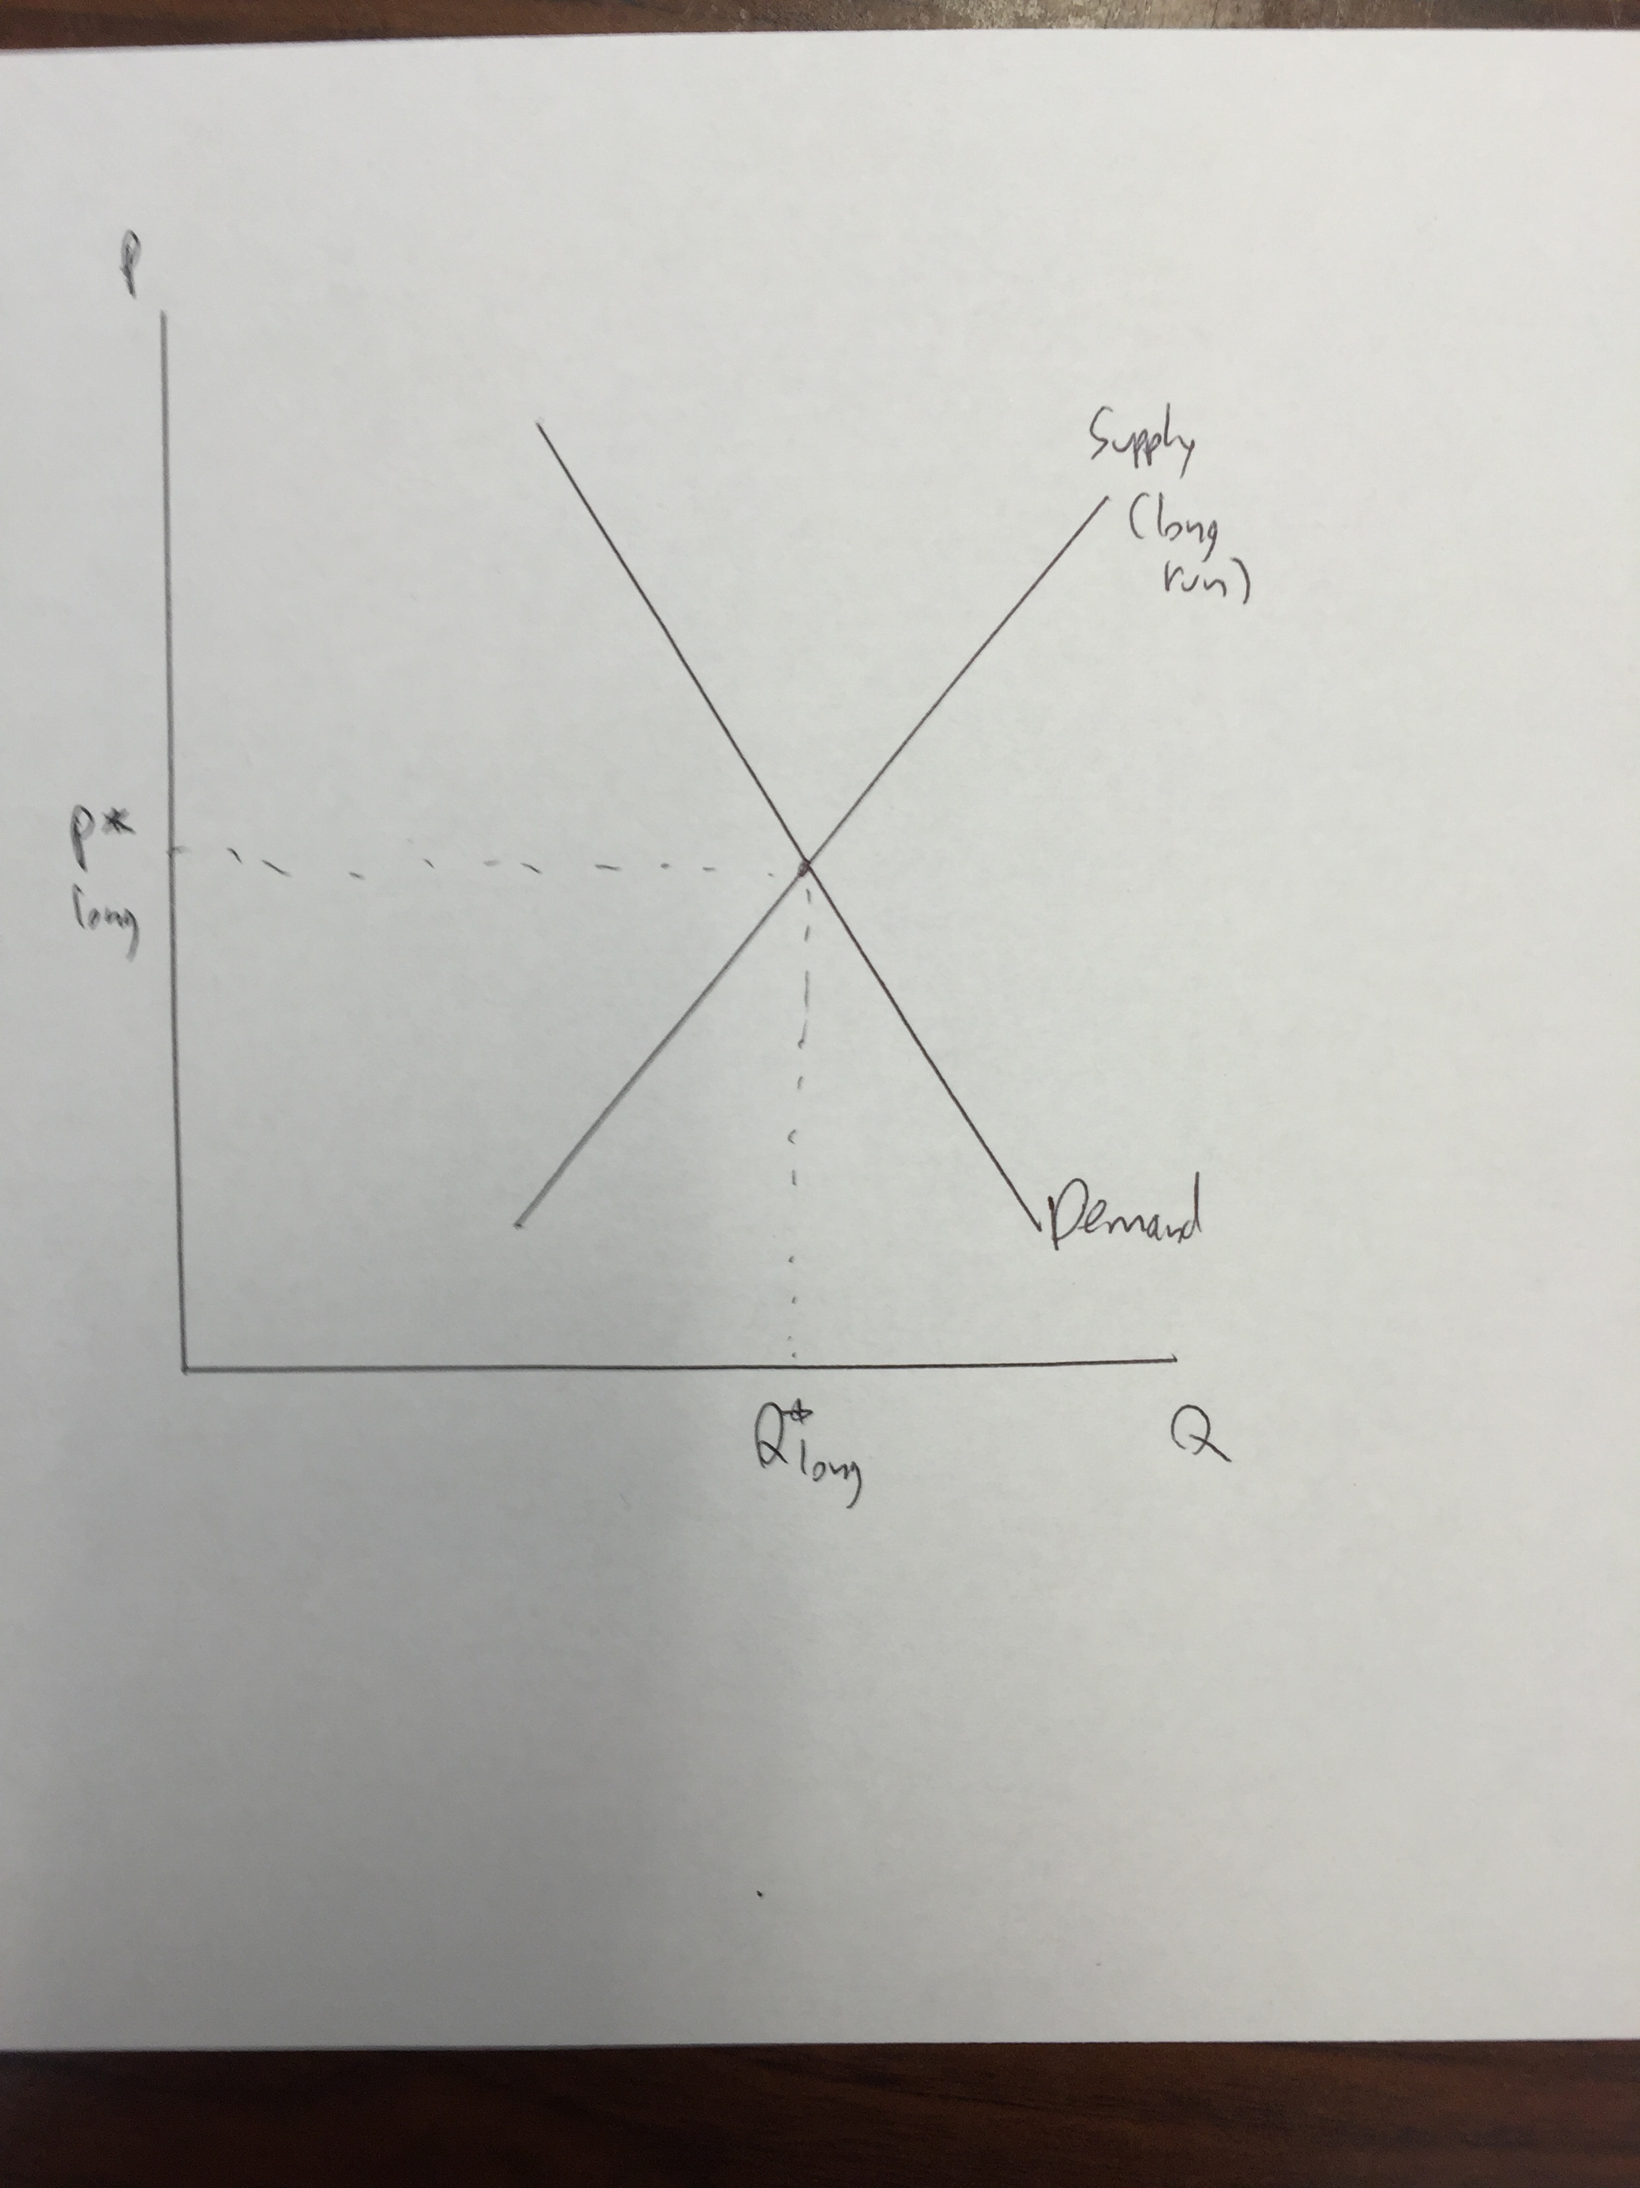
Long Run vs Short Run
The long run supply curve is upward sloping, as in the long run more housing gets built when prices are higher.

Slide 13
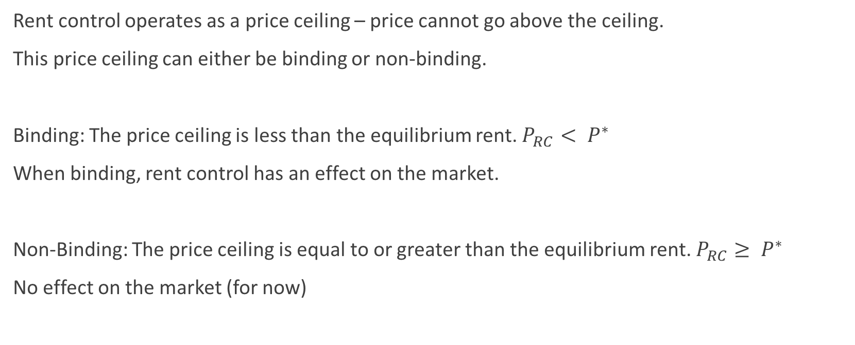
Addition of Rent Control
Rent control operates as a price ceiling – price cannot go above the ceiling.
This price ceiling can either be binding or non-binding.
Binding: The price ceiling is less than the equilibrium rent. $P_{RC}< P^{∗}$
When binding, rent control has an effect on the market.
Non-Binding: The price ceiling is equal to or greater than the equilibrium rent. $P_{RC}≥ P^{∗}$
No effect on the market (for now)

Slide 14
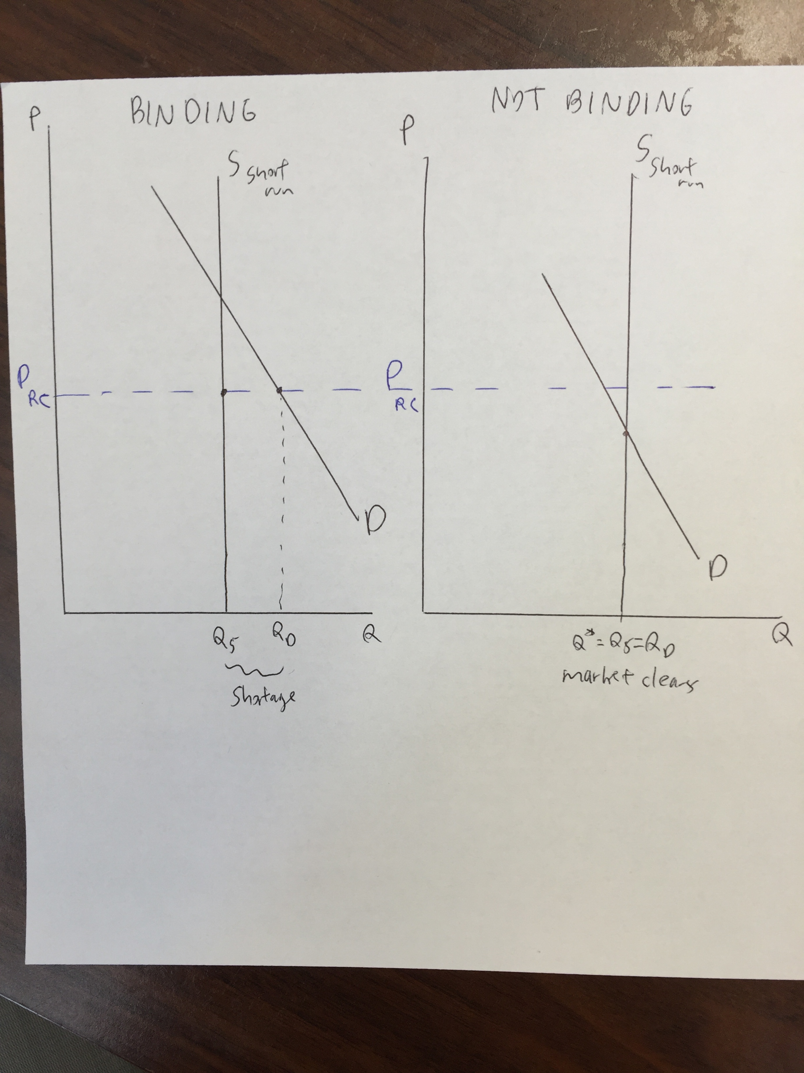
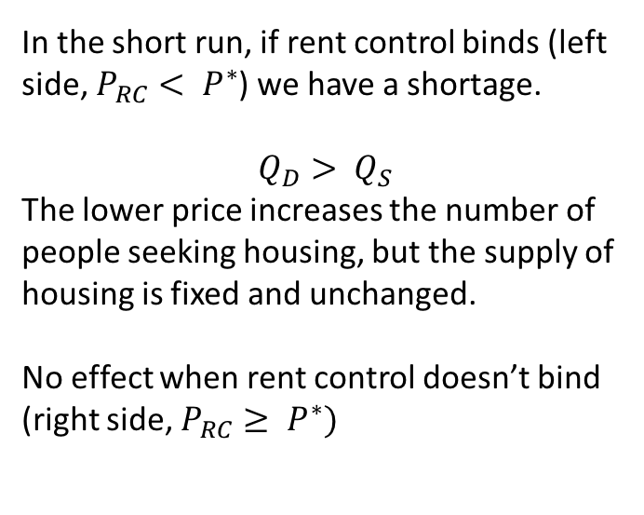
Short Run Effect
In the short run, if rent control binds (left side, $P_{RC}< P^{∗}$) we have a shortage.
$$Q_{D}> Q_{S}$$
The lower price increases the number of people seeking housing, but the supply of housing is fixed and unchanged.
No effect when rent control doesn’t bind (right side, $P_{RC}≥ P^{∗})$

Slide 15
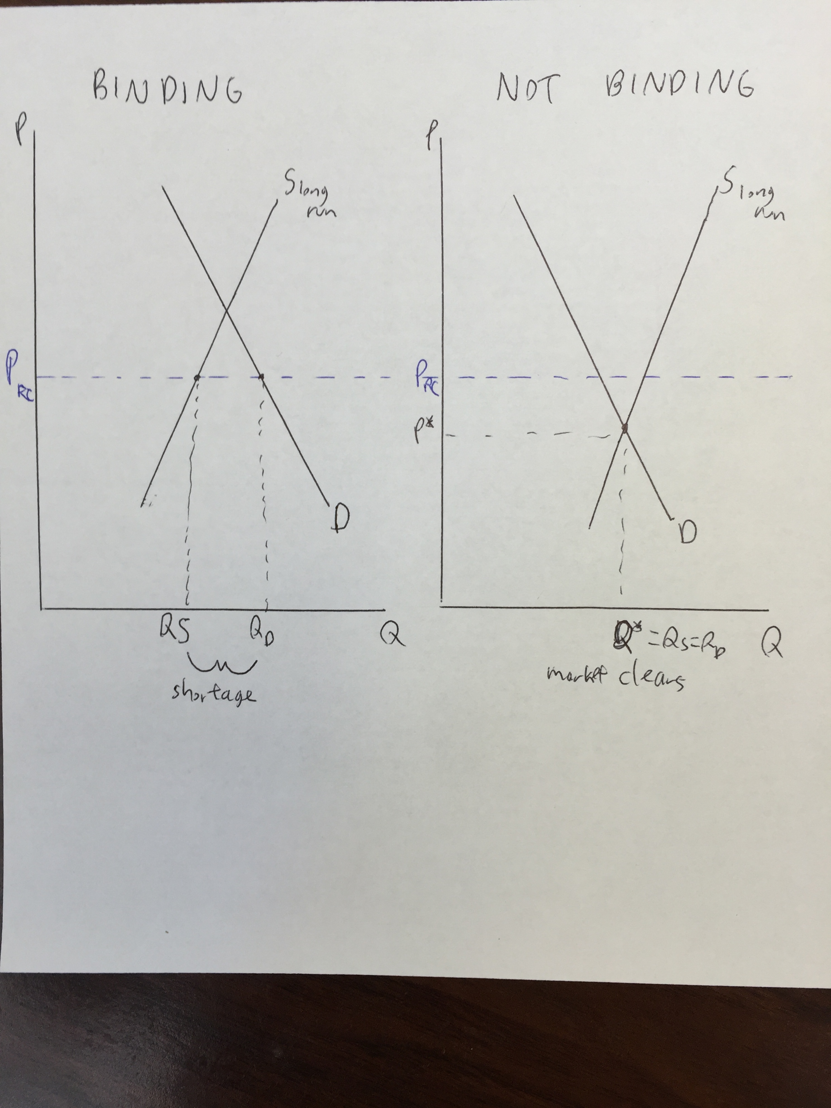
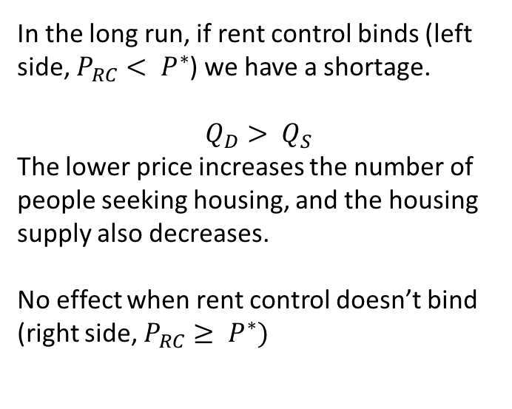
Long Run Effect
In the long run, if rent control binds (left side, $P_{RC}< P^{∗}$) we have a shortage.
$$Q_{D}> Q_{S}$$
The lower price increases the number of people seeking housing, and the housing supply also decreases.
No effect when rent control doesn’t bind (right side, $P_{RC}≥ P^{∗})$

Slide 16
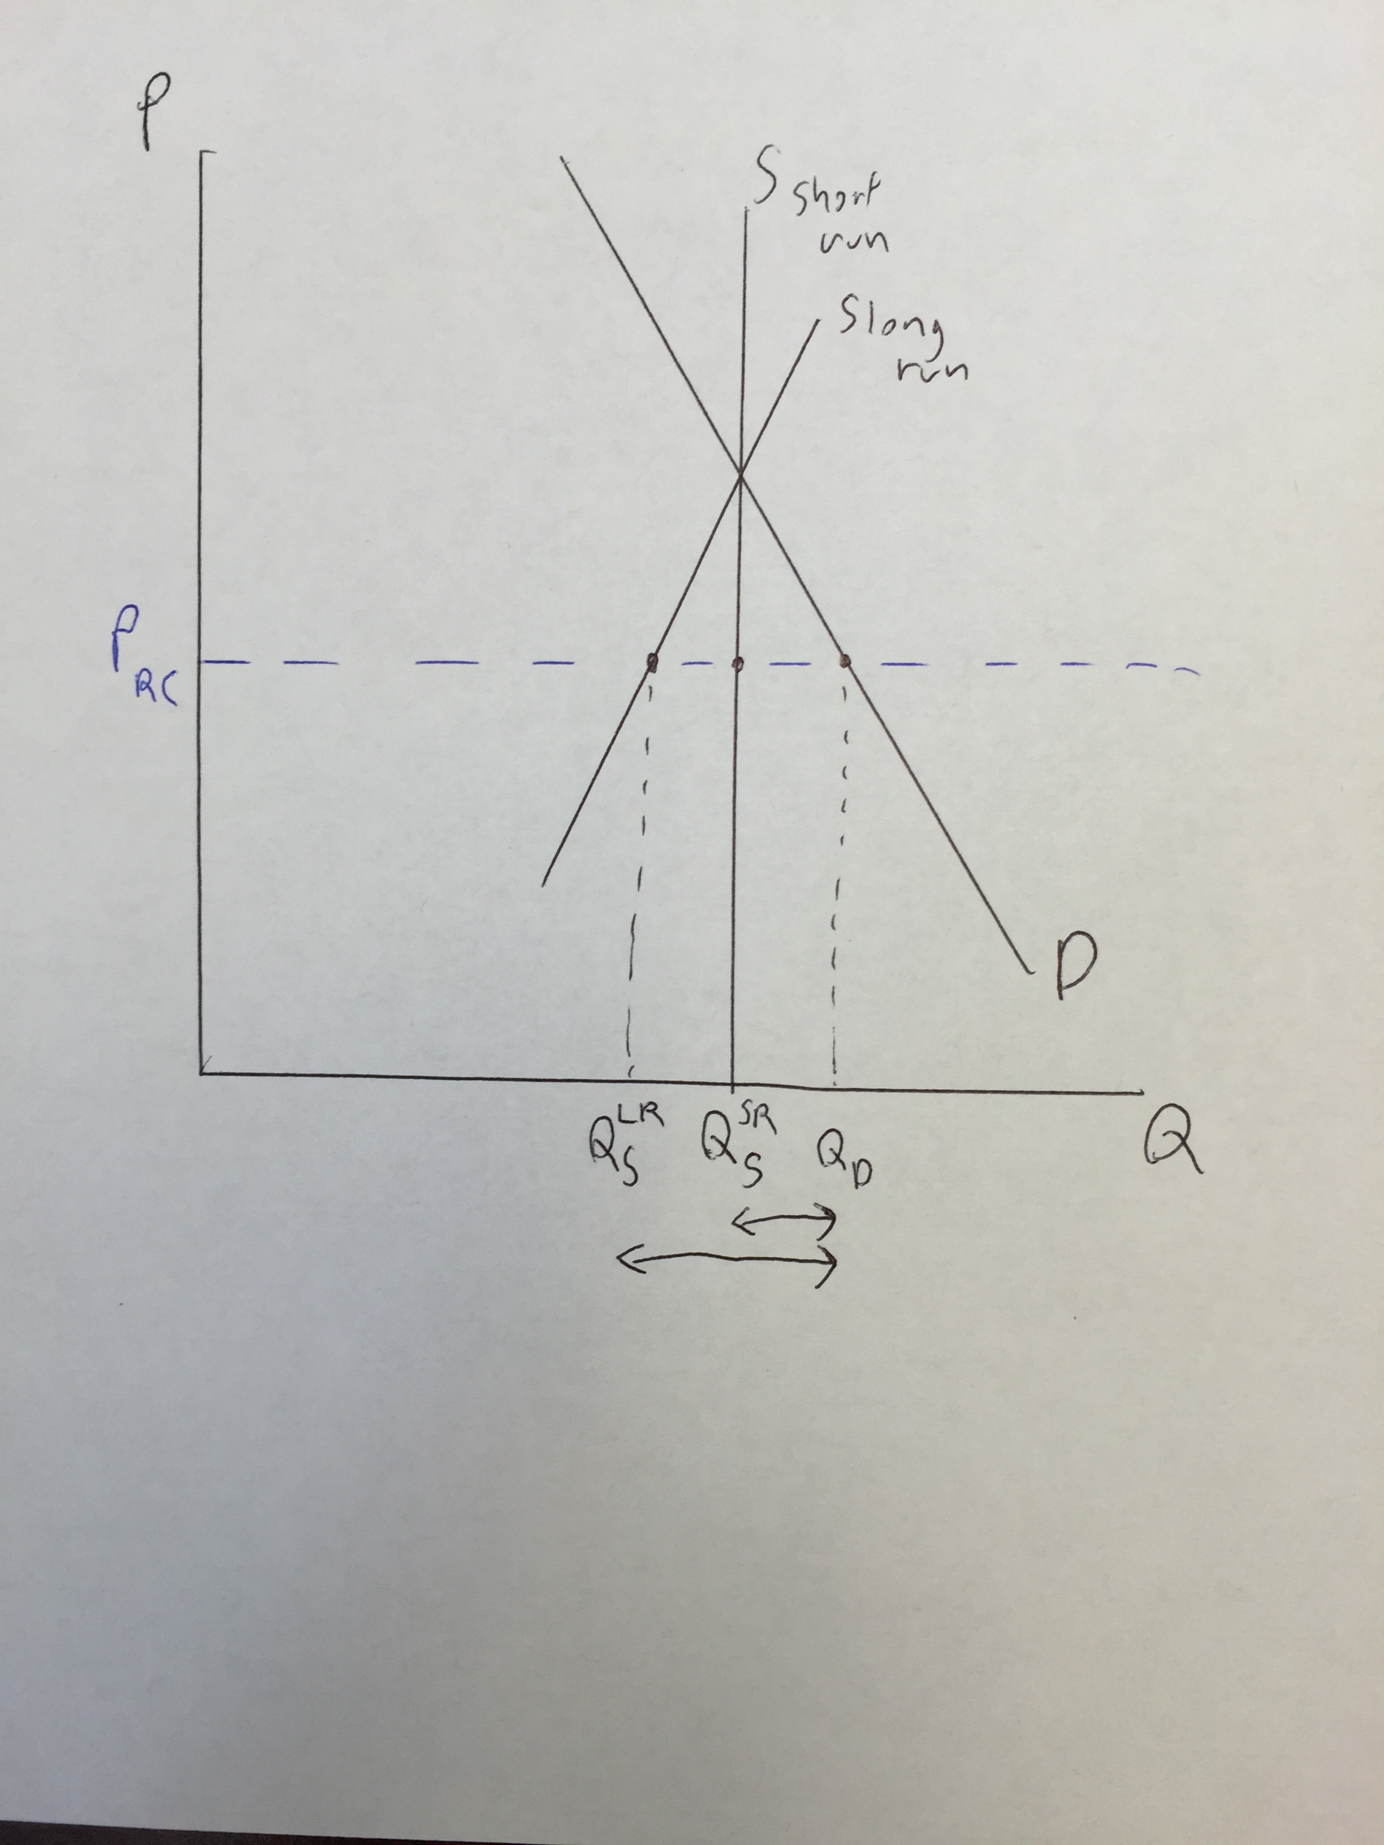
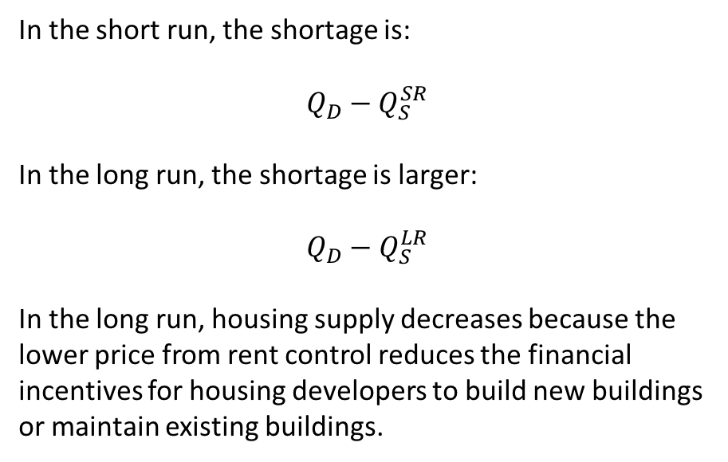
Short vs Long Run Shortage
In the short run, the shortage is:
$$Q_{D}−Q_{S}^{SR}$$
In the long run, the shortage is larger:
$$Q_{D}−Q_{S}^{LR}$$
In the long run, housing supply decreases because the lower price from rent control reduces the financial incentives for housing developers to build new buildings or maintain existing buildings.

Slide 17
Quality of Housing
In addition to a decrease in the quantity of housing in the long run, there is also a decrease in housing quality.
Since landlords get less in rent and face excess demand for their housing, they are less likely to make necessary repairs to buildings.

Slide 18
Allocation of Housing
In competitive markets that are unregulated, price is used as a mechanism to allocate the good to those who are most willing to pay.
With rent control, there is excess demand. Landlords can’t increase rents to clear the market.
How is housing allocated?

Slide 19
Illegal Fees or Side Payments
Attempt to bypass rent control by charging fees (usually illegal): e.g., key pickup fee, “deposits” beyond a security deposit.
Prospective tenants may also try to become the favored tenant by offering side payments.

Slide 20
Discrimination
With excess demand, landlords can be picky about who they want to rent to.
Landlords may screen out applicants based on perceived credit, socio-economic status, family type, pets, race, language, religion, sexual orientation, etc.
Those in poverty who need the cheaper housing are the most likely to be screened out.
While discrimination against protected groups is often illegal, it is not well enforced and not all groups are protected (e.g., LGBT)

Slide 21
Inefficient Allocation
With allocation of housing not determined based on price, there is scope for some individuals who have weaker preferences for housing to consume more housing than others who would have stronger preferences.
For example, suppose the equilibrium rent for an apartment would be $1,000 but under rent control it is $900. Suppose Steve is willing to pay $1,000.
With the rent being $900, there are some individuals who would try to rent the apartment who have a willingness to pay of $900 to $999. If they get the apartment over Steve then they get less consumer surplus than Steve, because the apartment is worth more to him.

Slide 22
Do Poor Families Benefit?
The hope would be that rent control would allow poor families to pay less in rent, thus partially alleviating their poverty.
But those lucky enough to get cheaper housing under rent control aren’t necessarily those who need it most.
Accoring to Gyourko and Linneman (1989), the beneficiaries of rent control are varied and the relationship is non-systematic. Beneficiaries aren’t from any particular social group.
Gyourko, Joseph, and Peter Linneman. 1989. “Equity and Efficiency Aspects of Rent Control: An Empirical Study of New York City” Journal of Urban Economics, 26, 54-74

Slide 23
Inefficient Mobility
Rent control can also encourage individuals and families to stay in apartments longer than they would normally, because if they move to rent a new place, the new places may have higher rent because landlords can increase the rent once individuals move out.
Thus some moves that would be efficient don’t happen. This reduces social welfare as there is some mis-match between where people live and where they should live.

Slide 24
Effects of Rent Control Under a Monopoly
There are two models of the economy that represent different extremes:
1) Perfect competition
2) Monopoly
Perfect competition predicts many negative effects of rent control. But under a monopoly, rent control isn’t so bad.

Slide 25
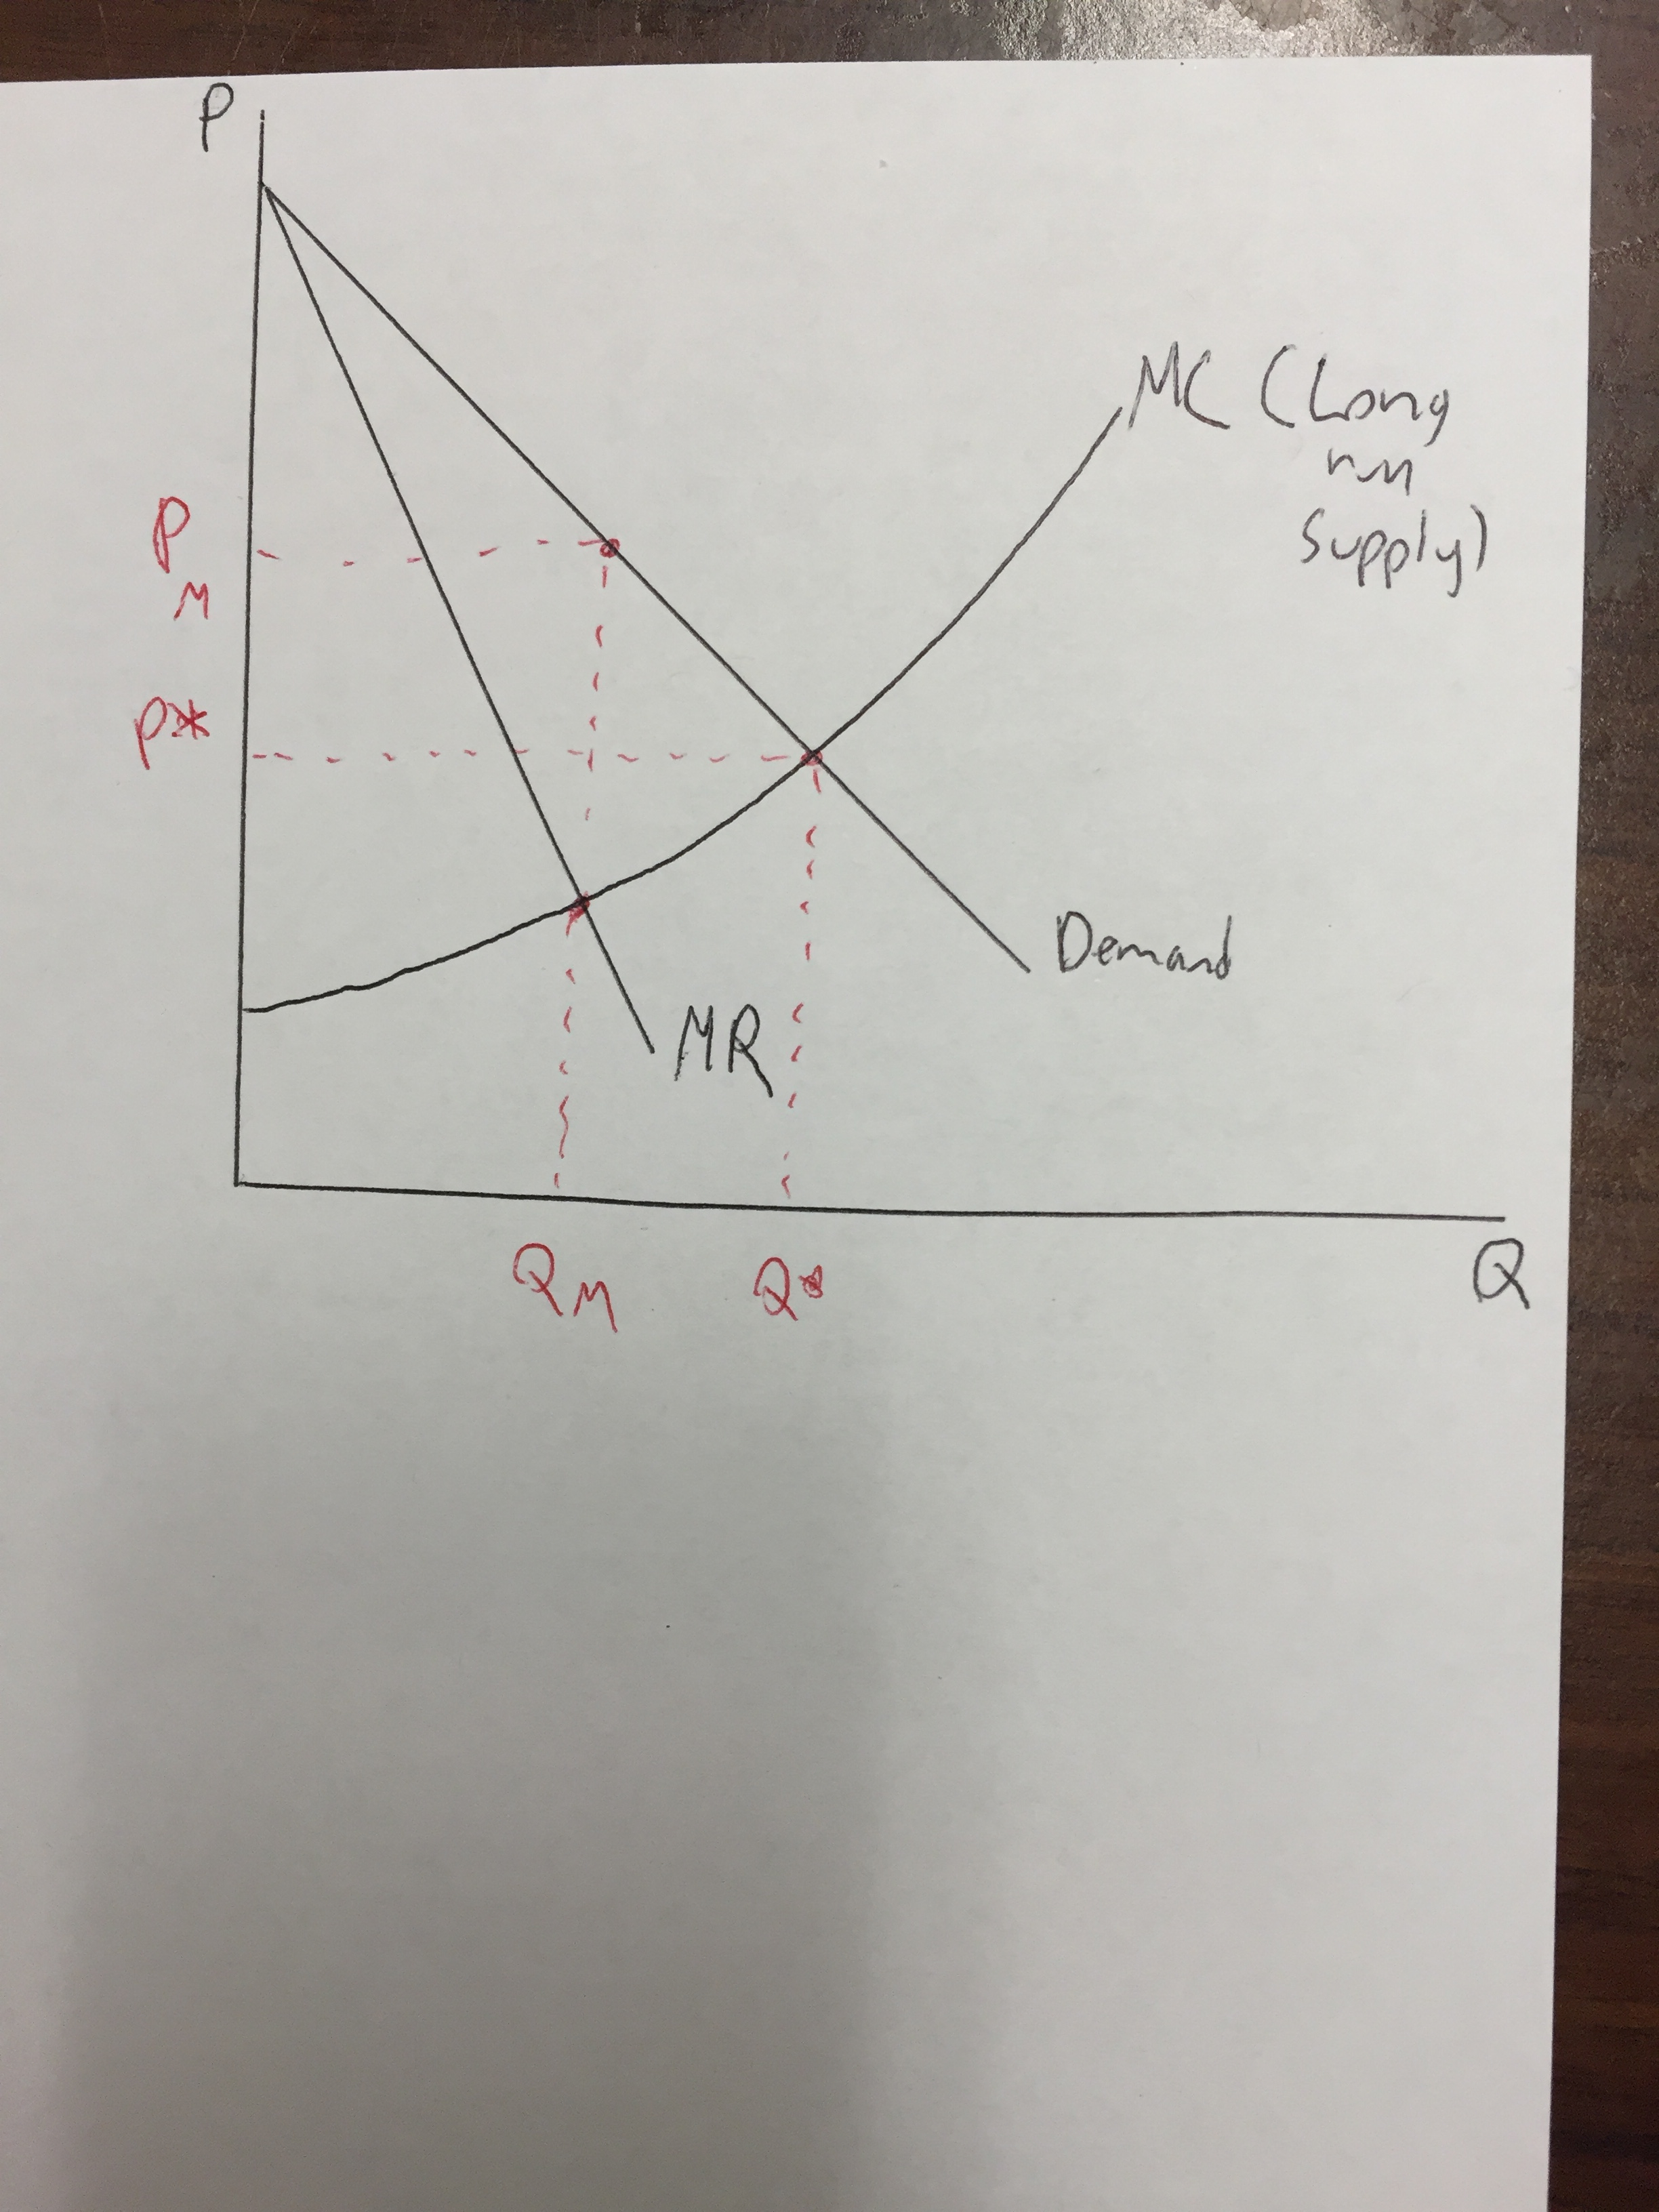
Monopoly (or when any firm has market power)
All firms set Q where MR = MC (for perfect competition, we have that P = MR but we have P > MR when there is market power)
Under monopoly, Price is set to PM and quantity of housing is set to QM. Price is set higher than the efficient level (P*).
Quantity in the long run is restricted to be too low (QM < Q*)

Slide 26
Monopoly – Application of Rent Control
There is a possibility that the rent control could has positive consequences.
If we set the price ceiling under rent control to be P* we can get the efficient price, but we can’t force the monopolist to change quantity.
The price decrease does improve consumer surplus, but there is no consumer surplus gained from adding addition units of Q since the monopolist won’t change Q.

Slide 27
Which model makes the most sense?
In most cities, there are many landlords and many tenants, so the market is very competitive.
Thus the perfect competition model is closer to reality, and the predictions of that model are more plausible.
But there are some cities where companies have lots of market power because they own all or most of the housing (e.g., Irvine Company in Irvine, CA). In this case, rent control might get prices closer to the efficient level if rent control is applied correctly.

